Slide 1

DX University
Bryce Canyon, UT – 2012

Slide 2
Contesting for DXers
Mike Fulcher KC7V

Slide 3
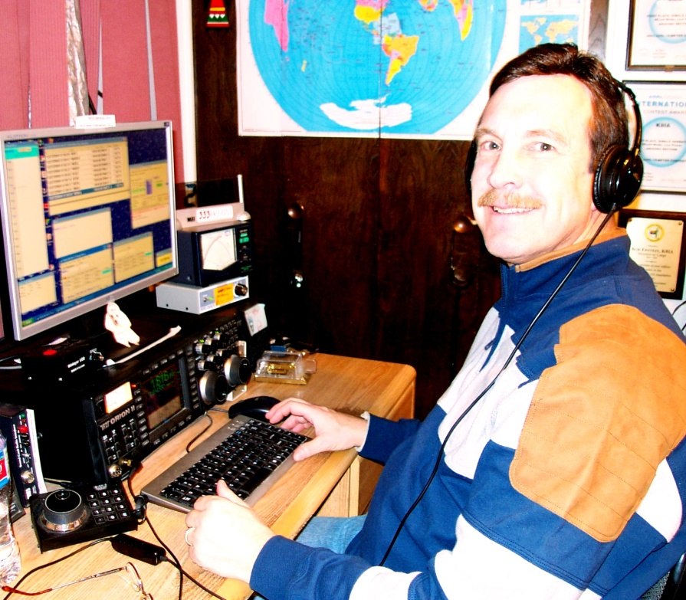
Mike Fulcher KC7V
First licensed in 1972 as WN9IXO. Has held many interesting calls and operated from 36 entities and 21 Zones.
Founding member of the VooDoo Contest Group. Member of FOC. Member and past President of CADXA. Founding member of the Arizona Outlaws Contesting Club.
Referee at WRTC in 1996 and 2006.

Slide 4
Contesting for DXers
  Good test of your station’s capabilities
  Good way to improve your operating skills
  Good way to learn how to use your equipment
  Helps improve your technical knowledge of equipment, antennas, software etc
  Good way to collect awards: DXCC, WAS, etc.
  It’s a challenge and a lot of fun!

Slide 5
Contesting for DXers
ANYONE CAN PLAY!
It doesn’t take a megabucks station
The big stations need QSOs from everyone!
Imagine being allowed to play in the Winter Olympics even if you are a once a week skier, or play in a beer hockey league!

Slide 6
Contesting for DXers
Many different types of contests
SSB, CW, RTTY, (other digital modes too) used in contests
DX
  ARRL, CQWW, IARU, WPX, foreign hosted, etc.
Domestic
Field Day, Sweepstakes, NAQP, VHF/UHF, State QSO Parties, etc.
Specialty
Single Band Contests (CQ 160, ARRL 10), Sprints, FOC Marathon, SOC, SKN, etc.

Slide 7
Contesting for DXers
Many different types of contests
SSB, CW, RTTY, (other digital modes too) used in contests
DX
  ARRL, CQWW, IARU, WPX, foreign hosted, etc.
Domestic
Field Day, Sweepstakes, NAQP, VHF/UHF, State QSO Parties, etc.
Specialty
Single Band Contests (CQ 160, ARRL 10), Sprints, FOC Marathon, SOC, SKN, etc.

Slide 8
Contesting for DXers
Exploit any antenna/propagation advantages you may have.
Start on the highest freq, open band that can be productive.
Change bands frequently (SO2R?).
Don’t get “ego driven” in pileups. The idea is to make contest points, not call endlessly in a “no-win” mess. ( My 3 call rule).

Slide 9
Contesting for DXers
Using the 12 db of HP advantage:
You will be above average on every band.
Take advantage of marginal propagation, band openings.
Operating strategy still very important.
Improve skills by managing pileup.

Slide 10
Contesting for DXers
When are contests run?
▪ Almost always on weekends
Starting/ending times vary by contest
  Durations as short as 2 hours
  As long as 48 hours
  Maximum allowed operating hours also vary
▪ Good on-line contest calendar: www.hornucopia.com/contestcal/

Slide 11
Contesting for DXers
Do I Have to Have a “Contest Station”?
Plenty of Big Gun contest stations
  Multiple radios
  Multiple towers
  Serious station automation
Also plenty of “normal” stations
Plenty of small stations too!
There are opportunities for “guest operating”
You don’t have to be a Big Gun
to have Big Fun contesting!

Slide 12
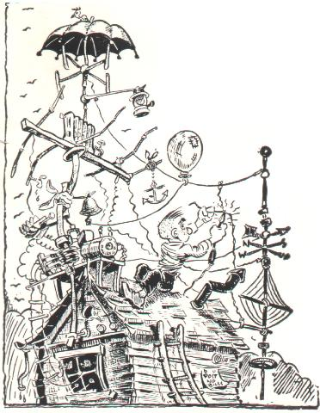
Contesting for DXers
Contest Antennas Can Be Anything…..almost ;-)

Slide 13
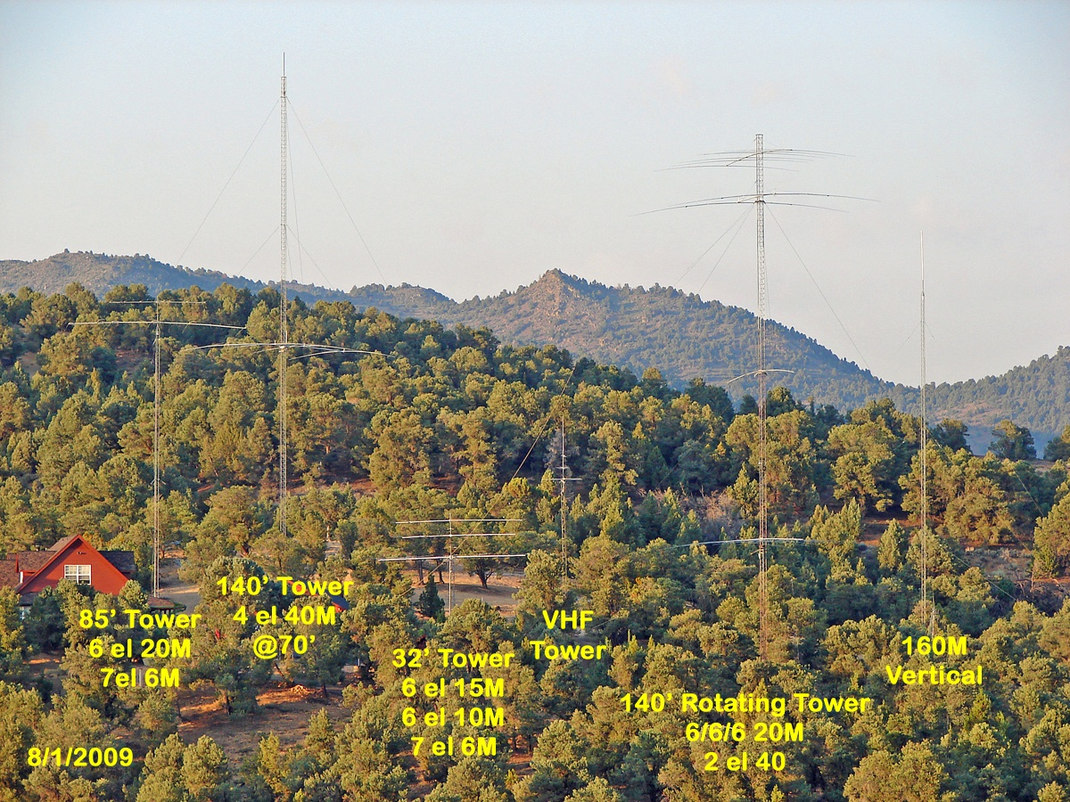
Contesting for DXers
Big Gun (USA)…K5RC/W7RN

Slide 14
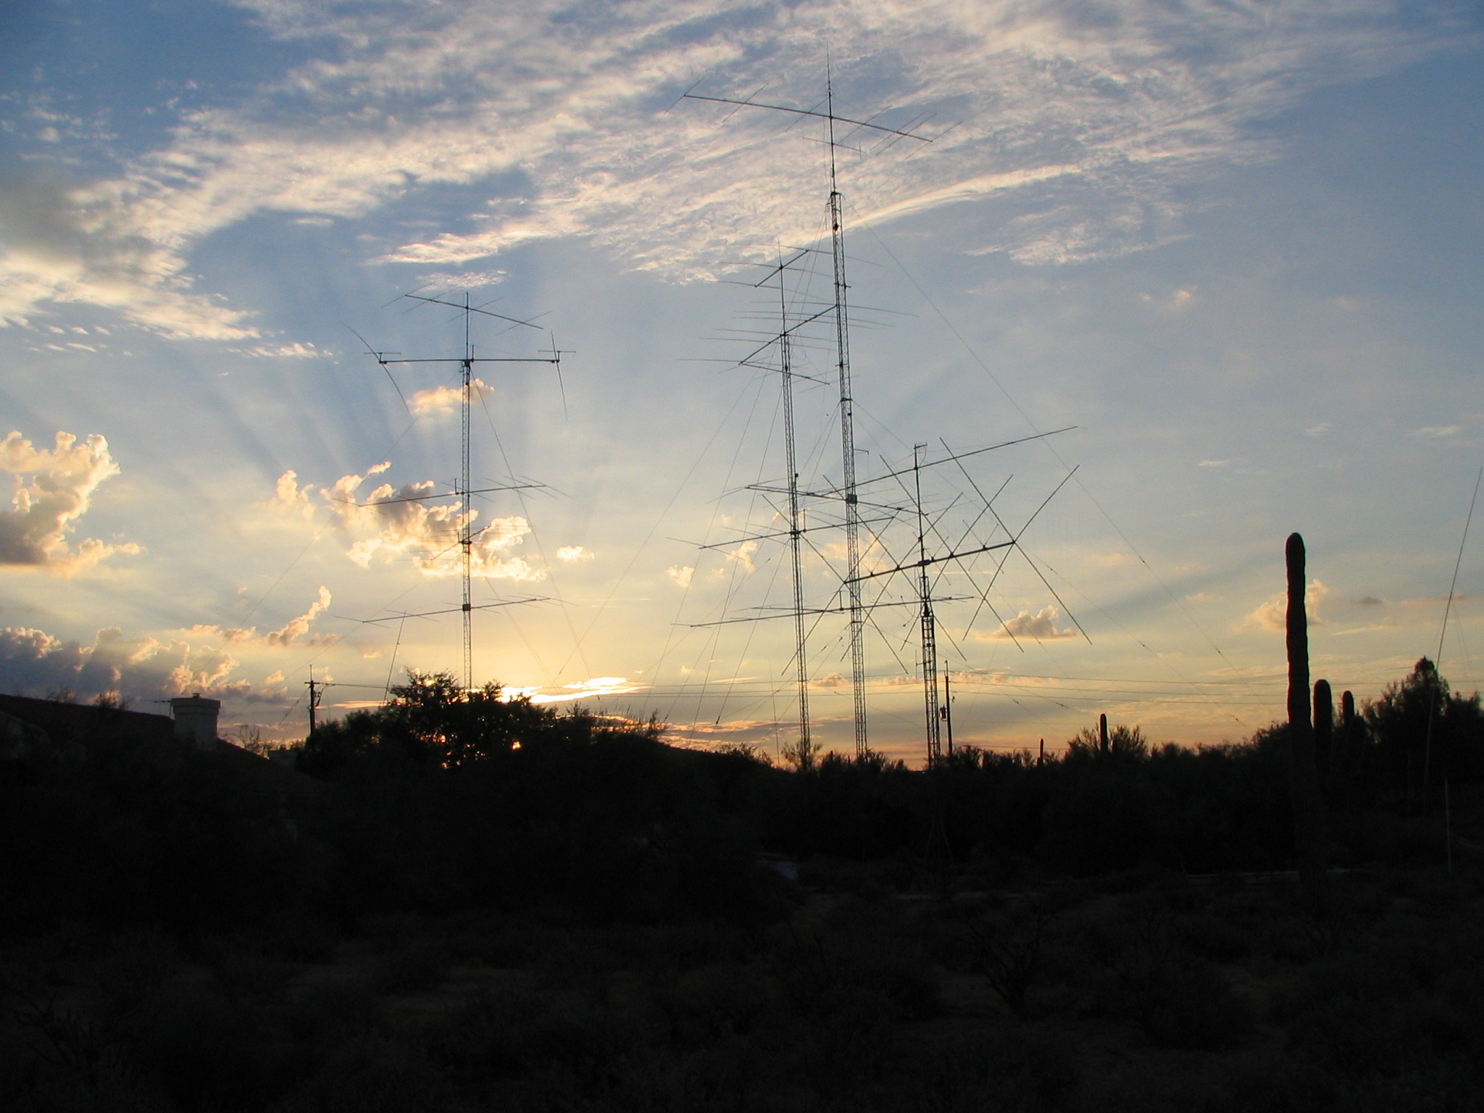
Contesting for DXers

Slide 15
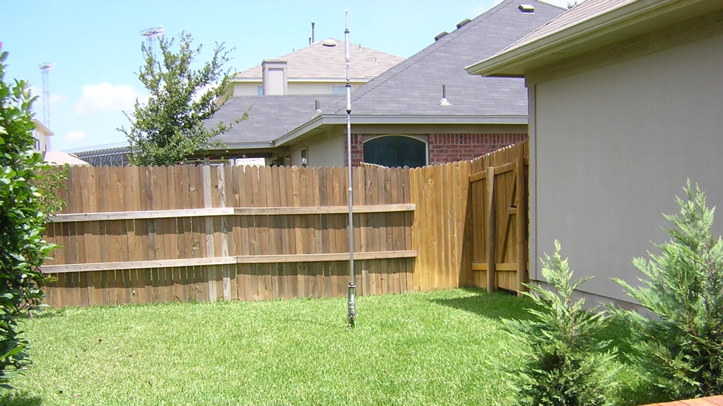
Contesting for DXers
……..Or Little Pistol/Cap Gun
No matter what size station you’re operating, it’s a thrill to talk to somebody far away.
Contests let you do that many times in one weekend!

Slide 16
Contesting for DXers
Online Contesting Resources
ARRL
  www.arrl.org
  “ARRL Rate Sheet” newsletter http://www.arrl.org/contests/rate-sheet/
Contesting.com
www.contesting.com
National Contest Journal
  www.ncjweb.com
  ARRL Affiliated Statewide Contest Club:
  Arizona Outlaws Contest Club
  www.arizonaoutlaws.net

Slide 17
Contesting for DXers
What’s Req’d to Get Started?
  Computer-based logging software
    o Many options from freeware to not free
      ▪ Windows-based
        N1MM (free) www.n1mm.com
        Win-Test ($70) www. win-test.com
        TR4W (TR for Windows) (free) www.tr4w.com
        WriteLog ($30/yr) www.writelog.com
        N3FJP ($39-49) www.n3fjp.com
        A radio and antennas

Slide 18
Contesting for DXers
Potential Results of participating
Work lots of new DX
On new bands
Improve operating skill
Less pileups to deal with
Easier pickings
Tremendous amount of fun
All in a weekend

